Slide 1
Credit Card Transaction Analysis
SQL Queries and Their Results

Slide 2
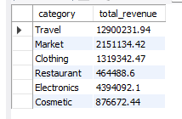
Calculate the total revenue generated by each category, from highest to lowest
Query:
SELECT category, ROUND(SUM(transaction_amount),2) AS total_revenue
FROM creditcard.transaction
GROUP BY category
ORDER BY transaction_amount DESC;
Result:

Slide 3
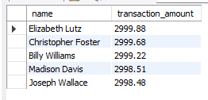
Identify the top 5 customers with the highest transaction amounts
Query:
SELECT CONCAT(name," ",surname) AS name, transaction_amount
FROM creditcard.transaction
ORDER BY transaction_amount DESC
LIMIT 5;
Result:

Slide 4
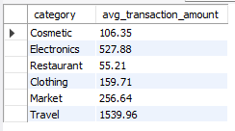
Analyze the average transaction amount by category, from lowest to highest
Query:
SELECT category, ROUND(AVG(transaction_amount),2) AS avg_transaction_amount
FROM creditcard.transaction
GROUP BY category
ORDER BY transaction_amount;
Result:

Slide 5

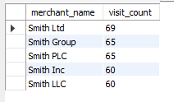
Determine the 5 most frequently visited merchants
Query:
SELECT merchant_name, COUNT(*) AS visit_count
FROM creditcard.transaction
GROUP BY merchant_name
ORDER BY visit_count DESC
LIMIT 5;
Result:

Slide 6

Calculate the revenue generated by the most visited merchant
Query:
WITH MerchantVisits AS (
SELECT merchant_name, COUNT(*) AS visit_count
FROM creditcard.transaction
GROUP BY merchant_name
ORDER BY visit_count DESC
LIMIT 1
)
SELECT merchant_name, ROUND(SUM(transaction_amount),2) AS revenue_generated
FROM creditcard.transaction
WHERE merchant_name = (SELECT merchant_name FROM MerchantVisits);
Result:

Slide 7
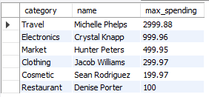
Find the top-spending customer in each category
Query:
SELECT category, CONCAT(name," ",surname) AS name, MAX(transaction_amount) AS max_spending
FROM creditcard.transaction
GROUP BY category
ORDER BY max_spending DESC;
Result:

